Slide 1
Continuous integration
(Jenkins) pipelines
Monorepos
Make & Ant
Statuschecks

Slide 2
Pipelines
Similarities with, e.g., Maven
Differences
Organize the build process into different phases/stages
Declaratively defined in a Jenkinsfile; can be placed in the repo (easier to read and maintain)
The POM.xml applies the same strategy
User-defined stages
A different approach than, e.g., Maven, where the lifecycle is fixed
Build language agnostic. Actually, it does not need any
Better support for monorepos
Versatility, e.g., distributed and parallel builds, pause/resume (across Jenkins shutdowns, etc.)

Slide 3
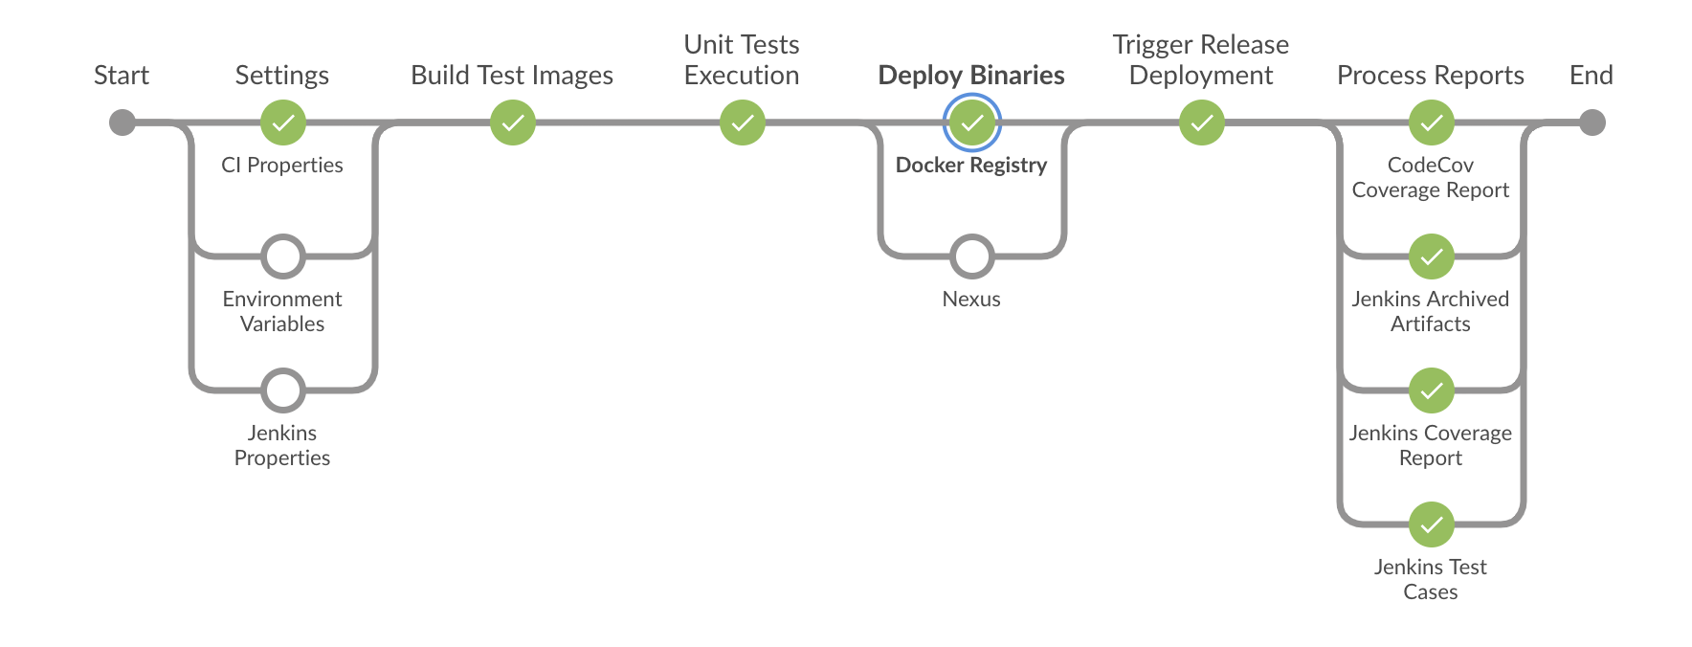
Pipeline: Concepts
Agent: The entity that manages a build
Node: A machine running Jenkins capable of executing a pipeline
Stage:
The building process may require different sets of tasks, e.g., compiling folders written in different languages, launching UI tests, etc.
A “stage” is a way to group and qualify these tasks
Step: A single task, e.g., running a set of test cases
Blue Ocean interface
https://stackoverflow.com/questions/53134681/how-to-add-icons-to-jenkins-blue-ocean-pipelines-stages-and-parameters-form

Slide 4
Pipeline: Three ways to create
Jenkins UI
Two flavors: Declarative and scripted (procedimental)
Blue Ocean and Jenkinsfile
Jenkinsfile alone
Pushed from the programmer’s desktop

Slide 5
Pipeline: UI
Go to Jenkins
Create a pipeline project
Choose “Pipeline script” (probably already selected)
Enter the code on the right (or choose the “Hello World!” example
Manually execute the pipeline
pipeline {
agent any
stages {
stage('Stage 1') {
steps {
echo 'Hello world!’
}
}
}
}

Slide 6
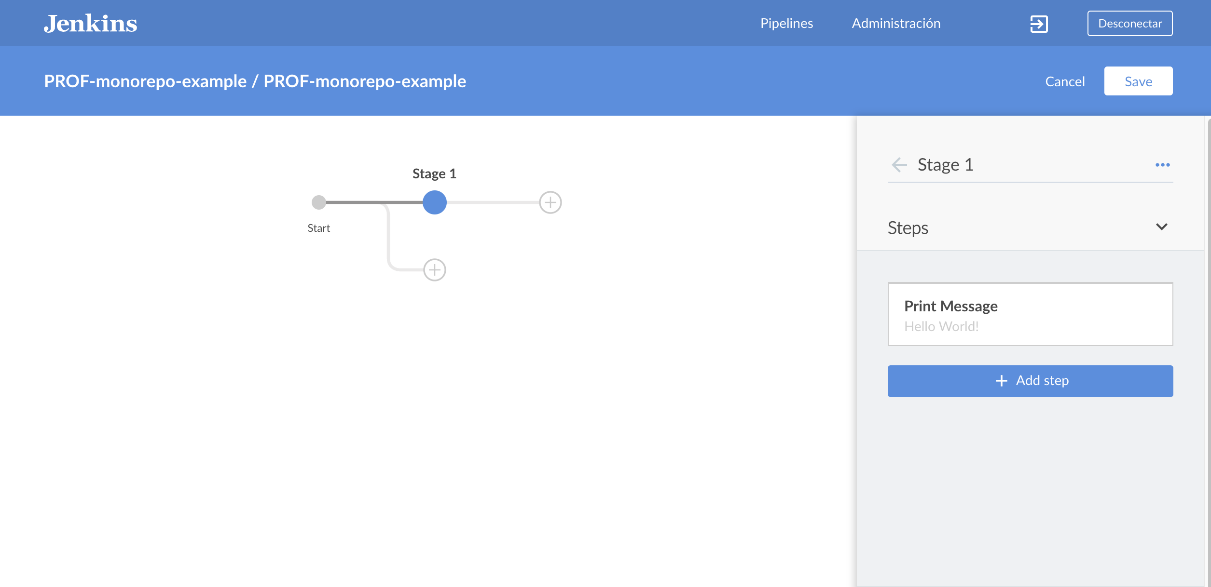
Pipeline: Blue Ocean + Jenkinsfile
Install the “Blue Ocean” plugin
Open Jenkins adding /blue at the end of the URL
Create a GitHub project
Create a pipeline in Blue Ocean using the options on the right
Add icons 🙂
https://stackoverflow.com/questions/53134681/how-to-add-icons-to-jenkins-blue-ocean-pipelines-stages-and-parameters-form

Slide 7
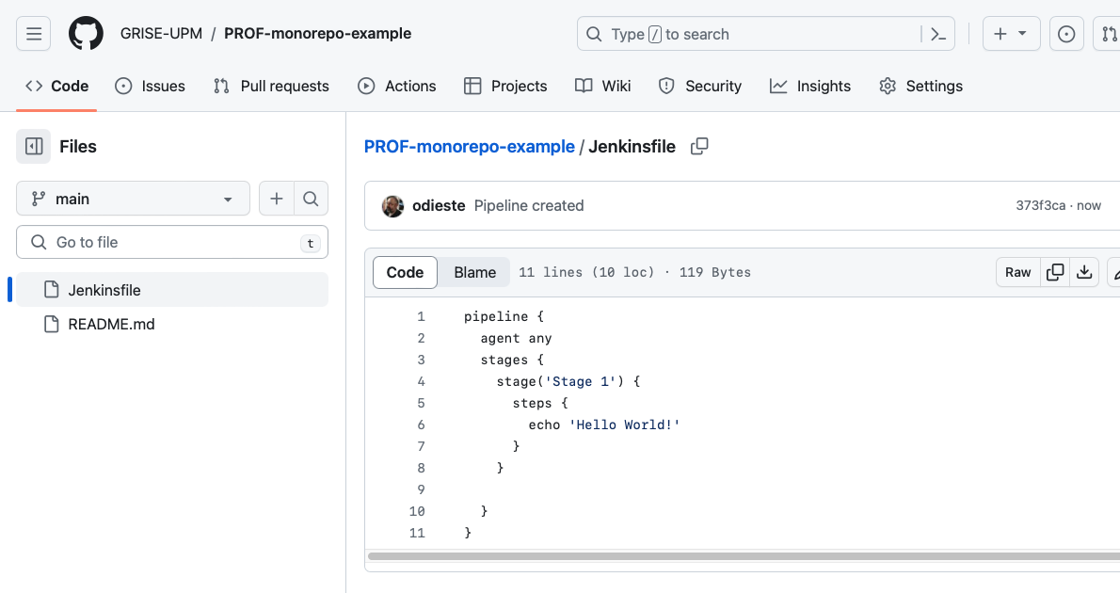
Pipeline: Blue Ocean + Jenkinsfile
The result is similar to the previous example
Note that this time the pipeline is (should be) stored in a Jenkisfile on GitHub
The build is declaratively defined and thus documented and subjected to configuration control

Slide 8
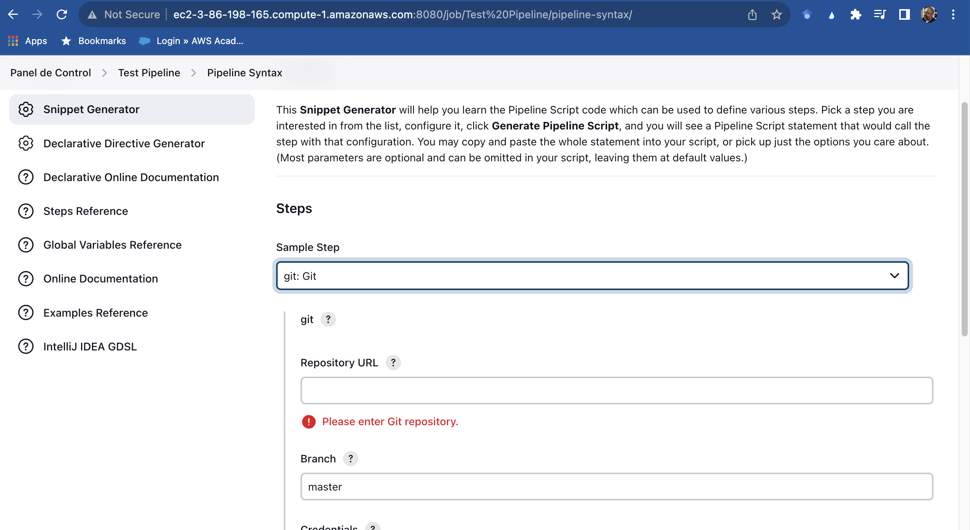
Pipeline: Snippet generator
Accessed by adding pipeline-syntax/ at the end of a project’s URL
It can be used to define directives and steps
Some knowledge required
The suggestions change depending on the installed plugins

Slide 9
Pipeline: Syntax Sections
Agent
Stage(s)
Step(s)
Post
For a complete reference, see https://www.jenkins.io/doc/book/pipeline/syntax/ . There are lots of

Slide 10
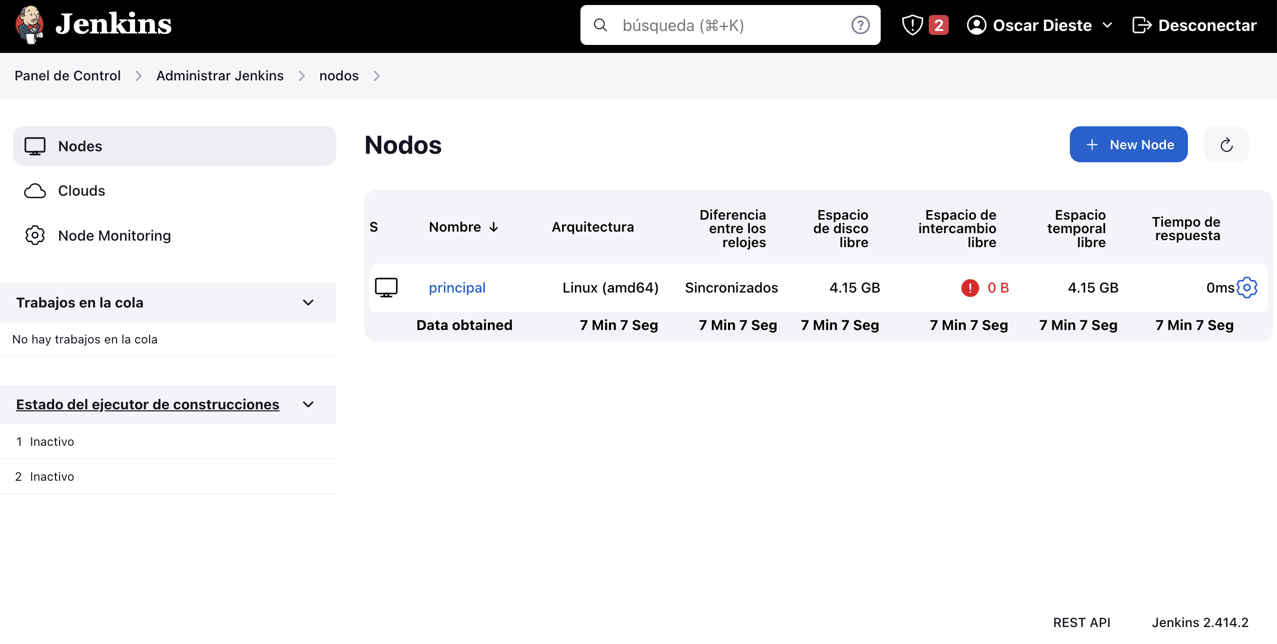
Pipeline: Syntax: Agent
Placed at the top level or in specific stages
Docker nodes seem the best choice
Agent {
none
any
label ‘<label>’
node {...}
docker {...}
dockerfile {...}
kubernetes {...}
}

Slide 11
Pipeline: Syntax: Post
Described post-steps depending on the fulfillment of certain conditions
Placed at the top level or in specific stages
pipeline {
agent any
stages {
stage('Example') {
steps {
echo 'Hello World'
}
}
}
post {
always {
echo 'I will always say Hello again!'
}
}
}

Slide 12
Pipeline: Syntax: Post: (some) Conditions
always: Run the steps in the post section regardless of the completion status of the Pipeline’s or stage’s run.
aborted: Only run the steps in post if the current Pipeline’s run has an "aborted" status, usually due to the Pipeline being manually aborted. This is typically denoted by gray in the web UI.
failure: Only run the steps in post if the current Pipeline’s or stage’s run has a "failed" status, typically denoted by red in the web UI.
success: Only run the steps in post if the current Pipeline’s or stage’s run has a "success" status, typically denoted by blue or green in the web UI.
cleanup: Run the steps in this post condition after every other post condition has been evaluated, regardless of the Pipeline or stage’s status.

Slide 13
Pipeline: Syntax Directives
Options
Parameters
Tools
When
For a complete reference, see https://www.jenkins.io/doc/book/pipeline/syntax/ . There are lots of

Slide 14
Pipeline: Syntax: Options
Pipeline/stage configuration
Placed at the top level …
… or in specific stages
Not all options are available in this case, e.g.,
options {
timeout(time: 1, unit: 'HOURS’)
skipStagesAfterUnstable()
retry(3)
}

Slide 15
Pipeline: Syntax: Parameters
Self-explanatory
parameters {
string(name: 'PERSON', defaultValue: 'Mr Jenkins', description: 'Who should I say hello to?')
text(name: 'BIOGRAPHY', defaultValue: '', description: 'Enter some information about the person')
booleanParam(name: 'TOGGLE', defaultValue: true, description: 'Toggle this value')
choice(name: 'CHOICE', choices: ['One', 'Two', 'Three'], description: 'Pick something')
password(name: 'PASSWORD', defaultValue: 'SECRET', description: 'Enter a password')
}
stages {
stage('Example') {
steps {
echo "Hello ${params.PERSON}”
}
}

Slide 16
Pipeline: Syntax: Tools
Automatically install tools and add them to the PATH
Maven
JDK
Gradle
The tool name must be pre-configured in Jenkins under Manage Jenkins → Tools.
tools {
maven 'apache-maven-3.0.1'
}

Slide 17
Pipeline: Syntax: When
pipeline {
agent any
stages {
stage('Example Build') {
steps {
echo 'Hello World'
}
}
stage('Example Deploy') {
when {
branch 'production'
}
steps {
echo 'Deploying'
}
}
}
}
Defines when a stage should be run based on not, allOf, or anyOf a set of conditions
Plenty of conditions, e.g, branch

Slide 18
Pipeline: Syntax: Triggers
Define the ways in which a pipeline is launched
Can be replaced by Jenkins triggers
pipeline {
agent any
triggers {
cron('H */4 * * 1-5')
}
stages {
stage('Example') {
steps {
echo 'Hello World'
}
}
}
}
triggers {
cron('H */4 * * 1-5’)
}
triggers {
pollSCM('H */4 * * 1-5’)
}

Slide 19
Pipeline: Steps
See https://www.jenkins.io/doc/pipeline/steps/

Slide 20

Example: Monorepo
Single repo containing different but related projects, e.g.,
React frontend + Express.js frontend + MySQL database DDL files
Monorepo $≠$ Monolyth
Special build languages, e.g., Bazel, Nx, Lerna
We will use pipelines today

Slide 21
Monorepo: Pros and Cons
Pros
Cons
Code Sharing and Reuse
Simplified Dependency Management
Ease of Collaboration
Atomic Commits and Cross-Project Changes
Increased Repository Size
More Complex Builds
Overwhelming for Newcomers
Scalability Issues
See https://medium.com/@alessandro.traversi/monorepos-advantages-and-disadvantages-233c1b7146c2

Slide 22
Example: Monorepo
See https://github.com/GRISE-UPM/PROF-monorepo-example
Two projects
C-based, make project
quicksort
Java-based, Ant project
arraysort
Arraysort
Uses the shared library quicksort.so
The expected location is <proyectdir>/lib

Slide 23
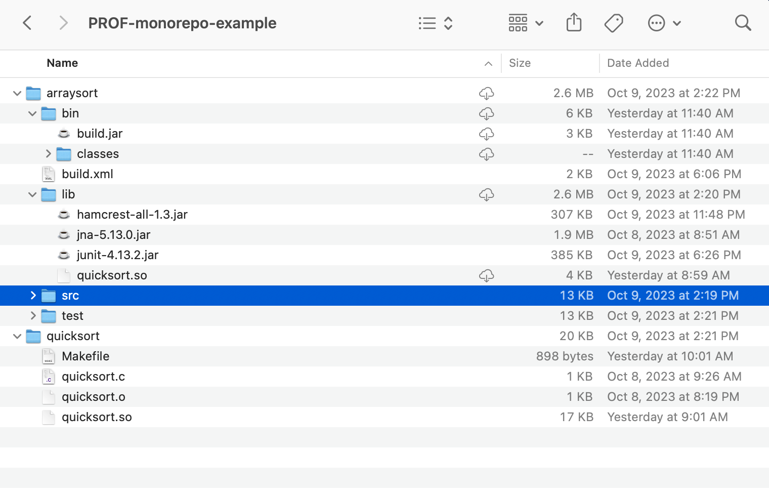
Monorepo: Chosen structure

Slide 24
Monorepo: Chosen structure

Slide 25
Monorepo: How to handle
Sparse checkout
git config core.sparseCheckout true
echo "some/dir/" >> .git/info/sparse-checkout
echo "another/sub/tree" >> .git/info/sparse-checkout
See https://stackoverflow.com/questions/600079/how-do-i-clone-a-subdirectory-only-of-a-git-repository

Slide 26
Make
# Macros
CC = gcc
CFLAGS = -c -std=c99 -fPIC -Wall
LFLAGS = -shared
# The first rule is executed
# by make if no rules are given
# The first rule is executed by make if no rules are given. Traditionally, the name is all, but that is not required. The following rule is actually unnecessary
all: quicksort.so
quicksort.so: quicksort.o
$(CC) $(LFLAGS) -o $@ quicksort.o
# $@ is replaced by the target name
# Rules have a given structure
#target #prerequisites
quicksort.o: quicksort.c
#tab #recipe (set of commands)
$(CC) $(CFLAGS) quicksort.c
# %.o: %.c
# $(CC) $(CFLAGS) $<
# $< is replaced by the first prerequisite. Use $^ if you want to retrieve all prerequisites. See https://www.gnu.org/software/make/manual/html_node/Automatic-Variables.html#Automatic-Variables for reference
#PHONY target (no prerequisites)
clean:
rm *.o
rm *.so
The timestamp of the target and prerequisites are compared.
When they differ, the build is launched
Stored in a Makefile
Cascaded makefiles are possible
cd <dir>
make

Slide 27
Apache Ant
<?xml version="1.0" encoding="UTF-8"?>
<project name="build" basedir="." default="main">
<property name="src.dir" value="src"/>
<property name="test.dir" value="test"/>
<property name="lib.dir" value="lib"/>
<property name="build.dir" value="bin"/>
<property name="classes.dir" value="${build.dir}/classes"/>
<property name="jar.dir" value="${build.dir}"/>
<property name="main-class"
value="es.upm.grise.prof.pipelines.JavaClassThatUsesQuicksort"/>
<path id="classpath">
<fileset dir="${lib.dir}" includes="*.jar"/>
</path>
<path id="application" location=”${classes.dir}"/>
<target name="clean">
<delete dir="${build.dir}"/>
</target>
<target name="compile">
<mkdir dir="${classes.dir}"/>
<javac fork="true"
srcdir="${src.dir}"
destdir="${classes.dir}"
classpathref="classpath"
includeantruntime="false" />
<copy todir="${classes.dir}">
<fileset dir="src" />
</copy>
</target>
…
Replacement of make
Heavily influenced by Java tools and conventions
Stored as build.xml in the project base directory
Targets and
recipes
md build/classes
javac
-sourcepath src
-d build/classes
src/<package>/<class>.java
From: https://www.adictosaltrabajo.com/2013/07/04/ant-jenkins-junit-sonar-jacoco/
From: https://ant.apache.org/manual/tutorial-HelloWorldWithAnt.html

Slide 28
Apache Ant
…
<target name="jar" depends="compile">
<mkdir dir="${jar.dir}"/>
<jar destfile="${jar.dir}/${ant.project.name}.jar"
basedir="${classes.dir}">
<manifest>
<attribute name="Main-Class" value="${main-class}"/>
</manifest>
</jar>
</target>
<target name="run" depends="jar">
<java jar="${jar.dir}/${ant.project.name}.jar" fork="true"/>
</target>
<target name="compile-tests”>
<mkdir dir="${classes.dir}-test"/>
<javac fork="true"
srcdir="${test.dir}"
destdir="${classes.dir}-test"
classpathref="classpath"
includeantruntime="false">
<classpath>
<pathelement location="${lib.dir}/junit-4.11.jar"/>
<path refid="application"/>
</classpath>
</javac>
</target>
…
md build/jar
echo Main-Class: <package>.<class> > mf
jar cfm
build/jar/HelloWorld.jar
mf
-C build/classes
.

Slide 29
Apache Ant
…
<target name="test" depends="compile-tests">
<junit printsummary="yes"
haltonfailure="yes">
<classpath>
<pathelement location="${lib.dir}/junit-4.13.2.jar"/>
<path location="${classes.dir}-test"/
</classpath>
<formatter type="xml"/>
<batchtest fork="yes"
todir="${test.dir}/reports">
<fileset dir="${test.dir}">
<include name="**/*Test.java"/>
</fileset>
</batchtest>
</junit>
</target>
<target name="clean-build" depends="clean,jar"/>
<target name="main" depends="clean-build"/>
<target name="run" depends="clean-build">
<java jar="${jar.dir}/${ant.project.name}.jar" fork="true"/>
</target>
</project>

Slide 30
Pipeline
pipeline {
agent any
stages {
stage('Compile quicksort project') {
steps {
sh '''cd quicksort
make'''
}
}
stage('Move shared library') {
steps {
sh '''cp quicksort/quicksort.so arraysort/lib'''
}
}
stage('Compile arraysort project') {
steps {
withAnt {
sh '''cd arraysort
ant compile'''
}
}
}
}

Slide 31
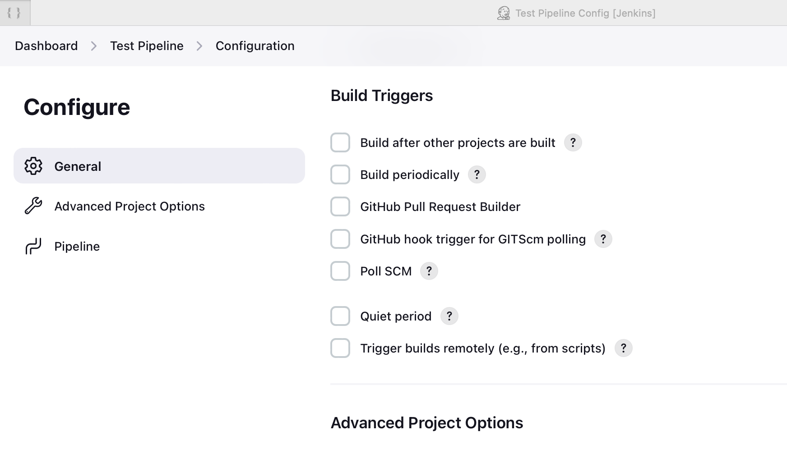
Pipeline: Launch: Pipelines Not multi-branch !
Triggers are provided in the Jenkins’ configuration tab
The pull request builder is particularly important
See also the “Triggers” syntax

Slide 32
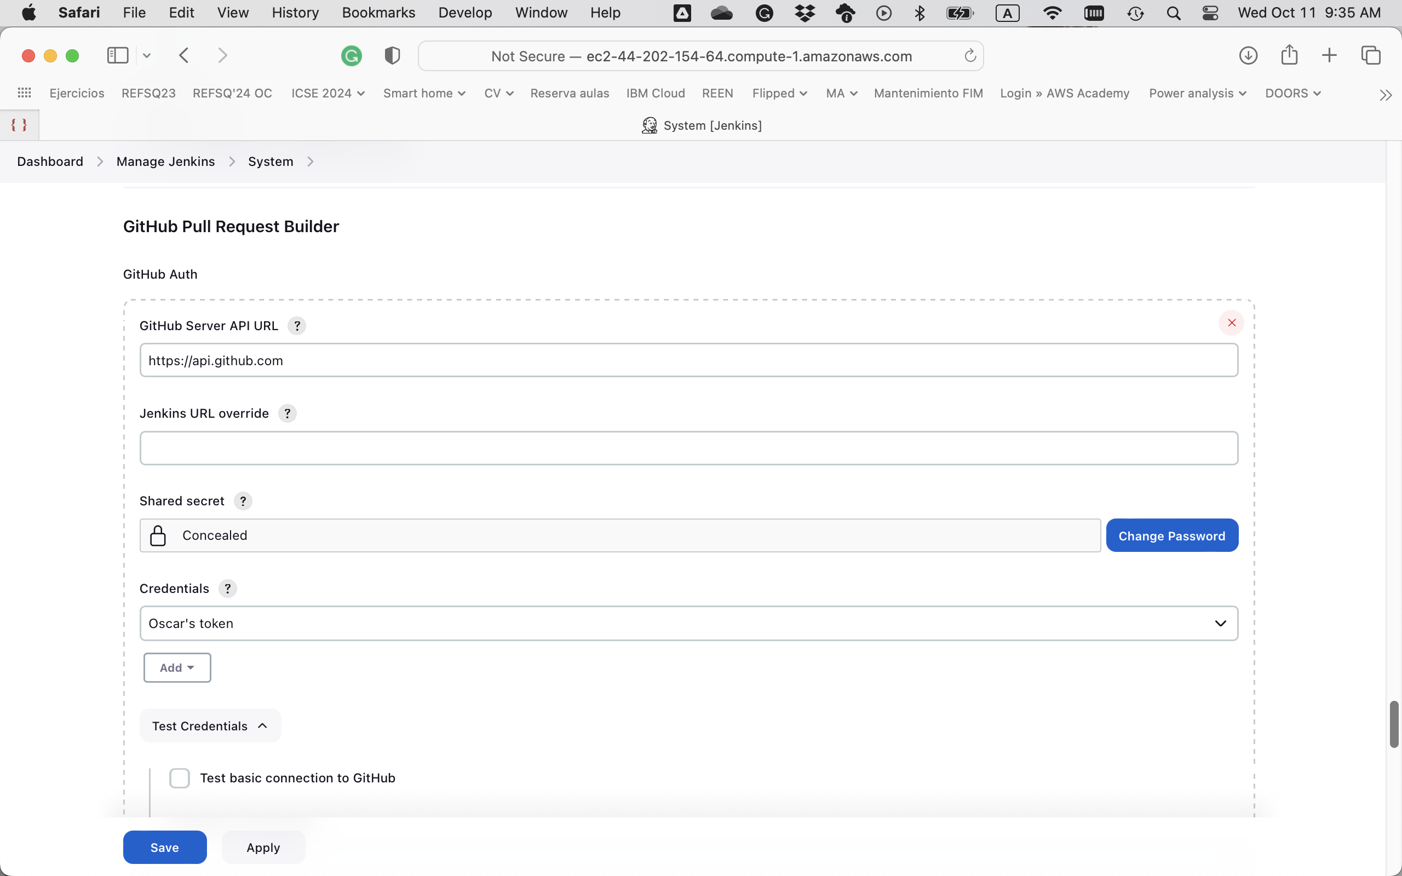
Pull request builder: Configuring credentials
Secret text, with
the following rights:
admin:repo_hook - for managing hooks (read, write and delete old ones)
repo - to see private repos
repo:status - to manipulate commit statuses

Slide 33
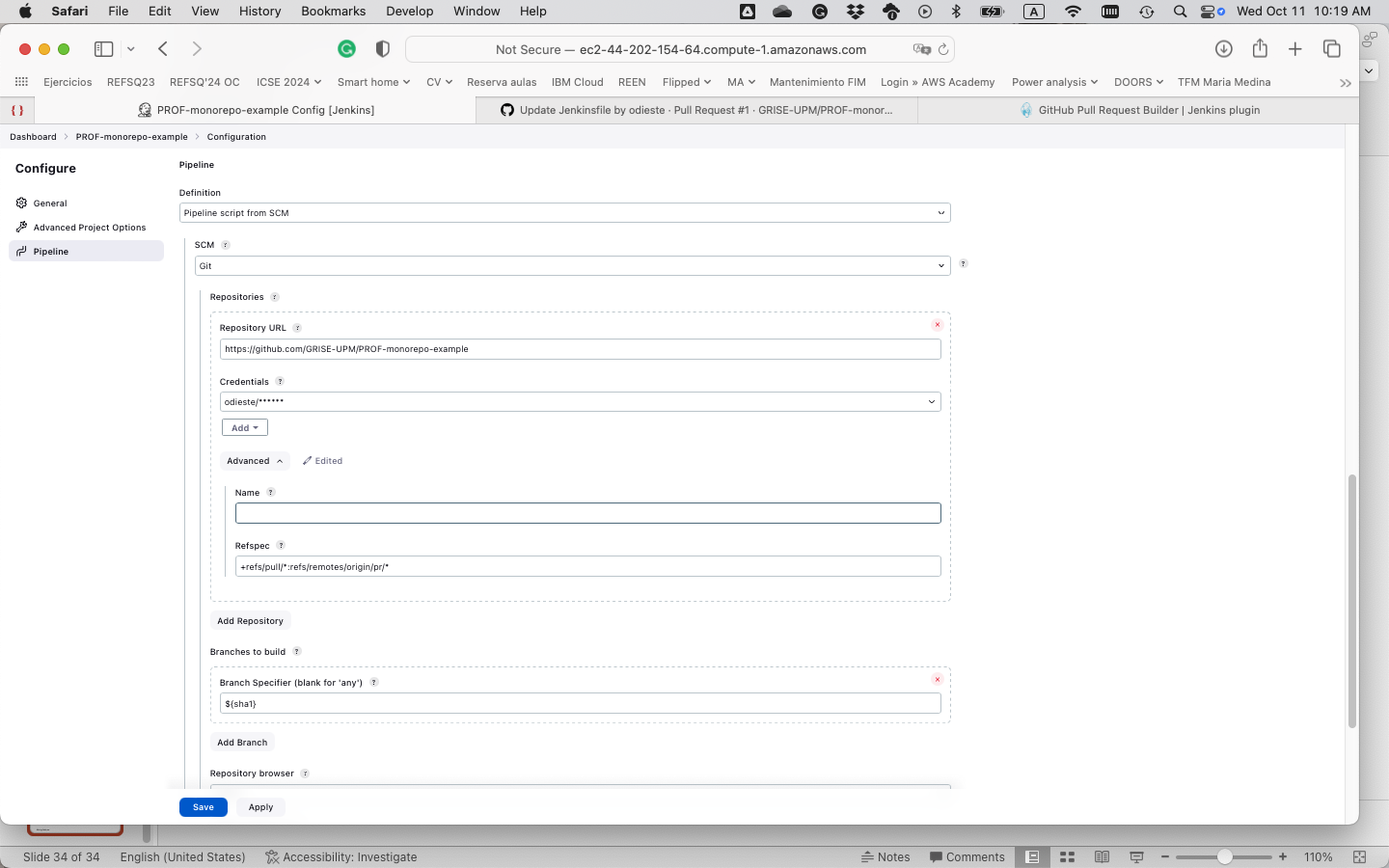
Pull request builder: Project configuration
See https://plugins.jenkins.io/ghprb/

Slide 34
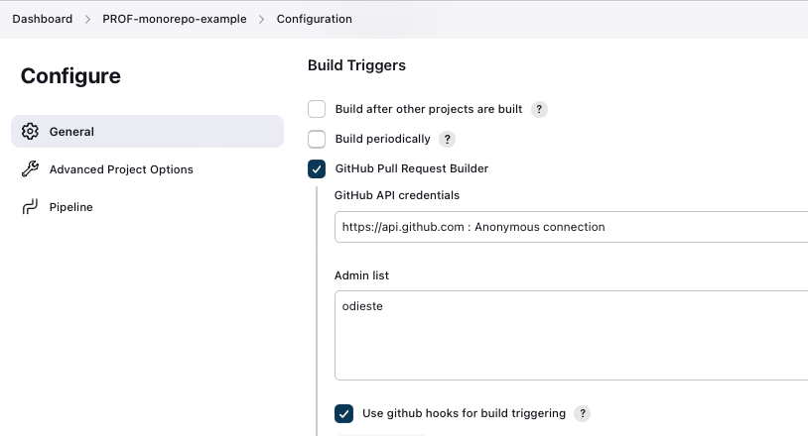
Pull request builder: Project configuration
??

Slide 35
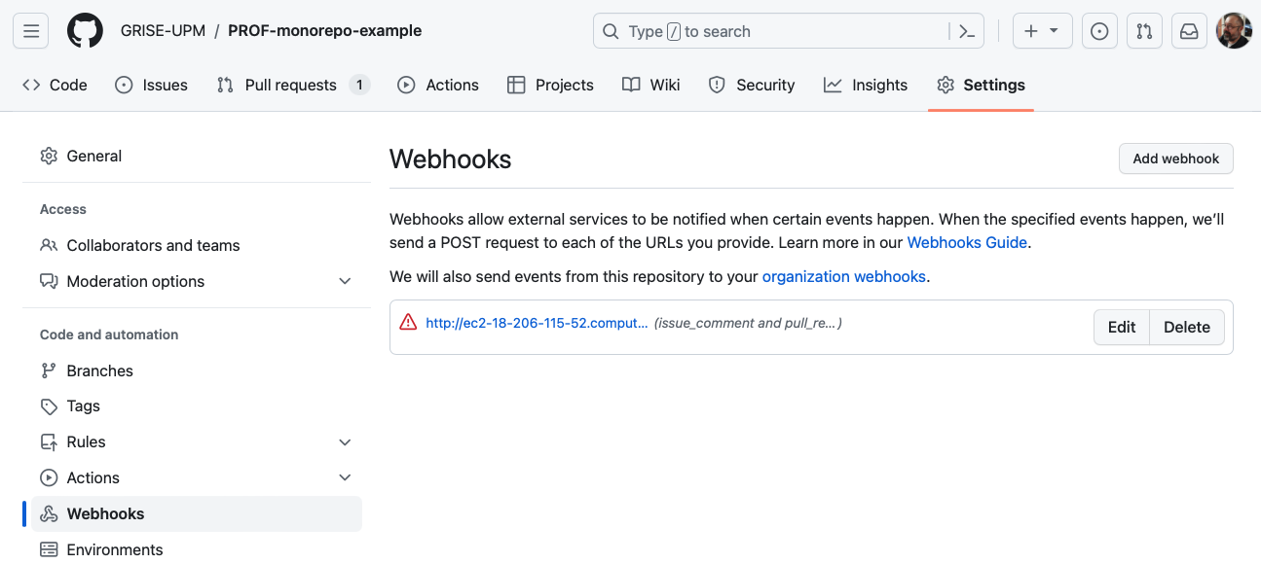
Pull request builder: Webhook

Slide 36
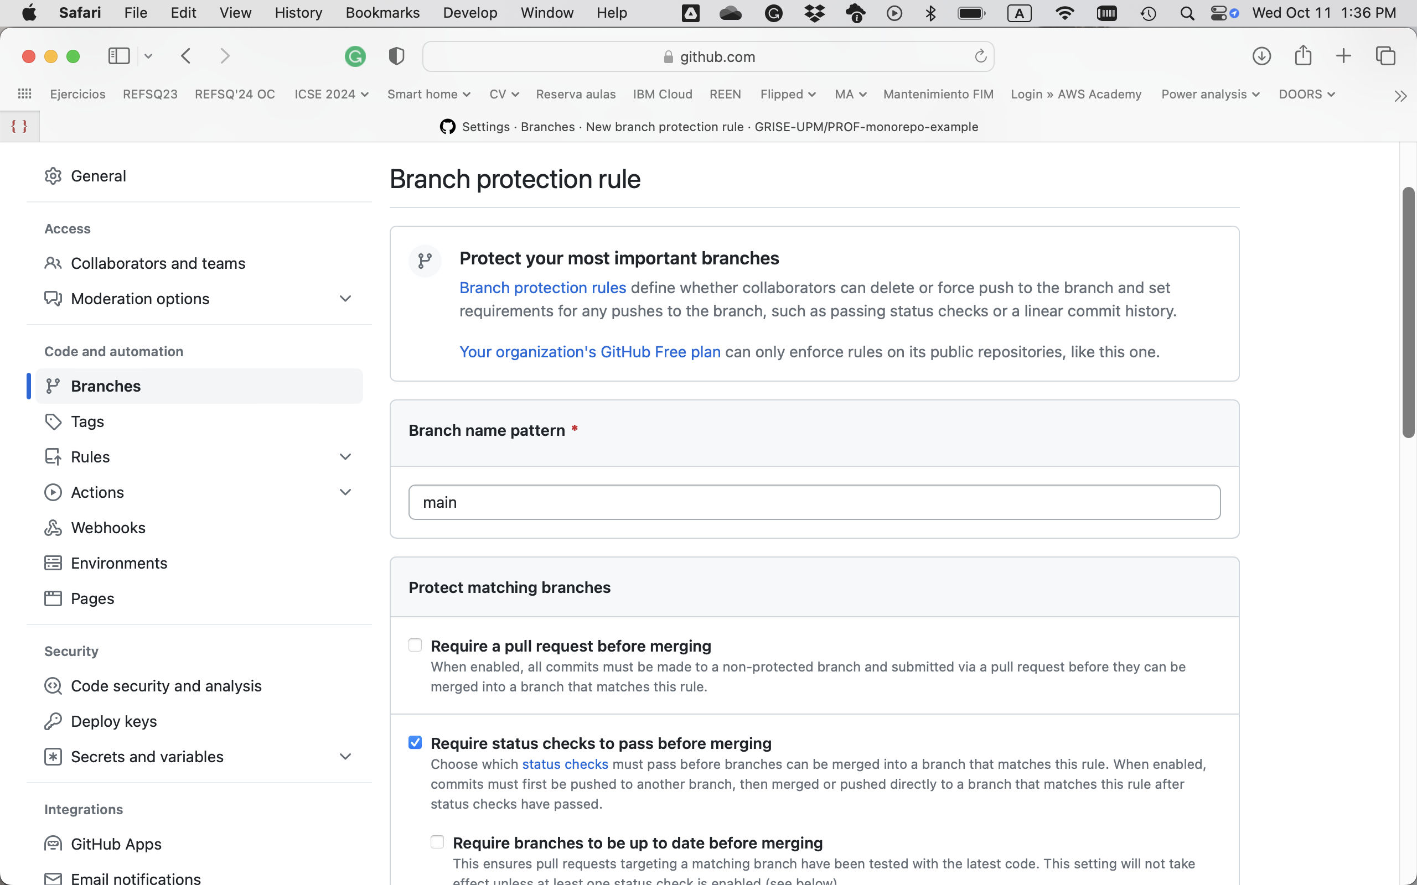
Pull request builder: Checks
Any tool can create checks
Branches can be protected based on these checks

Slide 37
Pipeline: Launch: Pipelines
triggers {
githubPullRequest {
admin('user_1')
admins(['user_2', 'user_3'])
userWhitelist('you@you.com')
userWhitelist(['me@me.com', 'they@they.com'])
orgWhitelist('my_github_org')
orgWhitelist(['your_github_org', 'another_org'])
cron('H/5 * * * *')
triggerPhrase('OK to test')
onlyTriggerPhrase()
useGitHubHooks()
permitAll()
autoCloseFailedPullRequests()
allowMembersOfWhitelistedOrgsAsAdmin()
extensions {
commitStatus {
context('deploy to staging site')
triggeredStatus('starting deployment to staging site...')
startedStatus('deploying to staging site...')
statusUrl('http://mystatussite.com/prs')
completedStatus('SUCCESS', 'All is well')
completedStatus('FAILURE', 'Something went wrong. Investigate!')
completedStatus('PENDING', 'still in progress...')
completedStatus('ERROR', 'Something went really wrong. Investigate!')
}
}
}
}
Alternative: Use the pipeline DSL
Requires the pull request builder
See https://plugins.jenkins.io/ghprb/

